Slide 1
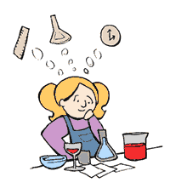
Unit 1: Measurement and The Scientific Method
Physical Science
Ms. Hanna

Slide 2
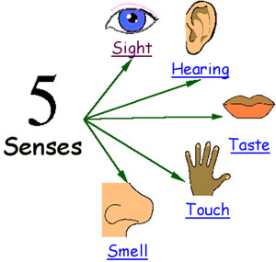
5 Senses

Slide 3
Observation: To use your _______________ to gather information
Inference: To give a possible _______________ for an observation

Slide 4
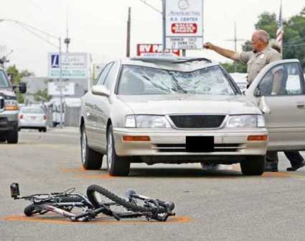
Example
Observation:
(What do you see)
_______________________
_______________________
_______________________
Inference:
(What do you think happened)
______________________________
______________________________
______________________________

Slide 5
Observation and Inference Demo
Observations (I see…)
Initial
1. ___________________
2. ___________________
After 1 change
1. ___________________
2. ___________________
After final change
___________________
Inferences (I think…)
Initial
1. ___________________
2. ___________________
After 1 change
1. ___________________
2. ___________________
After final change
___________________

Slide 6
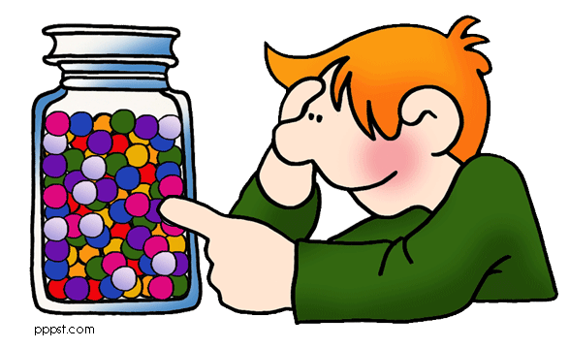
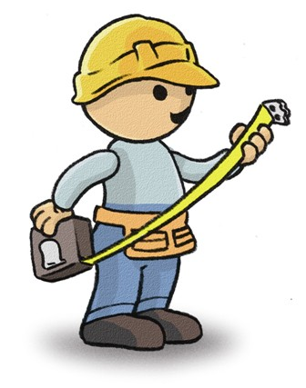
Estimate: to make a careful _______________
Ex. How many pieces of candy
(M&Ms) are in the container?
________________
(put your name and guess on a sticky and pass it up!)
Measure: To find the ___________ amount of something
Ex. Measure the object on your desk in cm. Record your measurement for length and width below
length: ________________________
width : _________________________

Slide 7
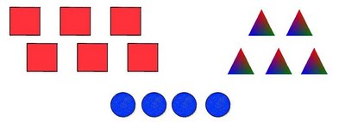
Predict: To guess about the _______________ based on the past.
Ex. Predict what the weather will be like in two days
Temperature: _______________________
Climate (rain/cloudy/sunny):_________________
Classify: To _______________ items based on how they are alike
Ex. Classify the group of animals in front of you in the bag. Write down below how or what characteristic you use to classify the animals.

Slide 8
Classification Activity
Classify the group of animals in front of you in the bag. Write down below how or what characteristic you use to classify the animals.
Group A: ____________________________________
Group B: _____________________________________
Group C: _____________________________________

Slide 9
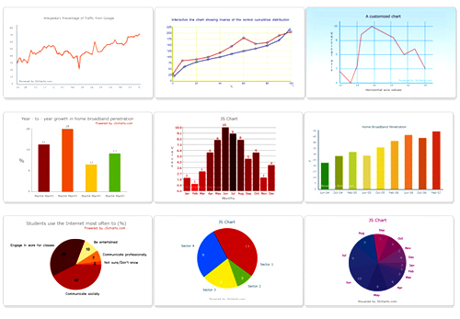
Hypothesize: To suggest an _______________ to a problem
Ex. What student do you think will have the middle most height in your class?
I believe that ___________________________ will have the middle most height
Was your hypothesis support or denied? ____________
Record and organize: To
take down ____________
(data) and arrange them
into a ____________ or a
____________

Slide 10
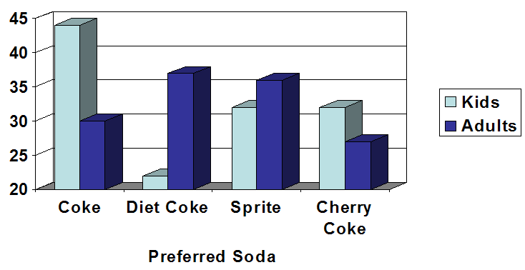
Conclusions: To give a ____________ result to a problem. Ex.
What is the preferred soda for kids?
What is the preferred soda for Adults?
So if you were throwing a party for a bunch of families, what beverages would you buy and why?

Slide 11
MEASUREMENT
The following notes include topics on measuring
Rulers
Areas
Volume (solid and liquid)
Mass

Slide 12
Measurement Skills
Converting through the metric system. Use the following chart to convert the measurements.
kids hide down under desks chewing mints
KILO → HECTO → DECA → (UNITS) → DECI → CENTI → MILLI
Km hm dam m dm cm mm
55 mm = __________________ cm
1.3 m = ___________________cm
15 m = ___________________ km
4.02 cm = ___________________mm
76.23 km = _________________________m
0.3 cm = ________________________m

Slide 13
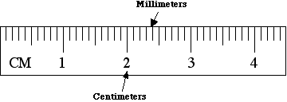
Measuring with a Metric Ruler
When measuring with a metric ruler all answers must be in decimal form and must include the centimeters followed by a decimal then the millimeters.

Slide 14
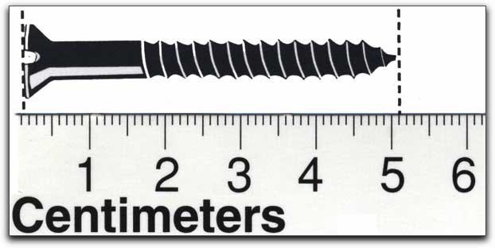
What is the measurement of the screw ?
In cm? ______________________
In mm? _____________________

Slide 15
Measuring area using a ruler
Area = _________ X _________
Units of area = cm² or mm² or m²
Find the area of the block below:
Show work below
F = L X W
S = ________ X ________
(L) (W)
A =____________ ____ (units)

Slide 16
Measuring volume with a graduated cylinder
Graduated cylinders come in many different ________: including 10 ml, 25 ml, 50 ml, 100 ml, 500 ml, and 1000 ml.
Graduated cylinders are used to determine the volume of __________ ______________
An interesting characteristic of liquids in glass containers is that they curve at the edges due to cohesion forces (like a straw). This curvature is called the _______________.
- With water in glass, the meniscus will _______ _____ at the edges and down in the center, just like the smile on this smiley face.

Slide 17
When reading a graduated cylinder you want to:
- measure the ___________ portion of the meniscus.
- be eye level with the ______ of the liquid
read the _________ of the meniscus
- Units for liquid volume = _____ or _____

Slide 18
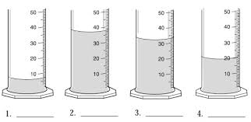
What are the volumes of these liquids?

Slide 19
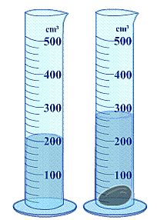
What is the volume of object?
Volume of the Liquid (A) = _________
Volume of the liquid and object (B) = ______
(B) - (A) = volume of object
Volume of object = ________

Slide 20
Measuring volume for solid objects using a ruler
Volume = _________ X _________ X _________
Units for volume = _________ or _________ or _________ Find the volume of the block below
Show work below:
F = l x w x h
S= __________ X ___________ X __________
A= __________ __________(units)
4.2 cm
3.6 cm
9.4 cm

Slide 21
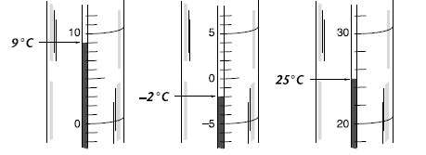
Measuring Temperature
Temperature is the measure of how _________ or _________ something is
The correct unit of temperature in the metric system is _________ Thermometers are read _________ when temperatures are above zero
Thermometers are read __________________ when temperatures are below zero. They will also have a _________ sign in front of the temperature.
Examples:

Slide 22
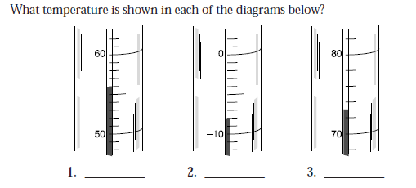
4. Suppose that at 9:00 A.M. the temperature of a room is 18°C, and at noon it is 24°C.What was the increase in temperature?

Slide 23
Measuring Mass
A unit of mass in the metric system is the _________
Metric mass is measured in the science laboratory by the measuring device called a _________ _________ _________
The parts are all labeled in the picture to the below.

Slide 24
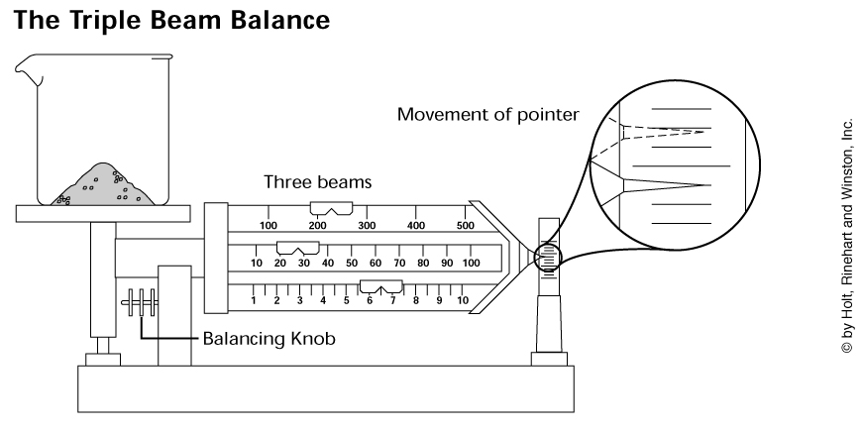
STEPS TO USE TBB
1) Pointer is pointing to ________________
Q: Pointer above the zero?
A: turn the knob ___________ you (down)
Q: Pointer below the zero
A: turn the knob ___________ from you (up)
2) Put object on measuring tray

Slide 25
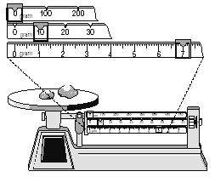
3) Move the riders
start with the 100s rider…stop at each 100. When the pointer drops, go back 1 space
then the 10s rider…stop at each 10. When the pointer drops, go back 1 space
lastly move the 1s rider until the pointer is on the line
4) Add all the riders together to get the final mass
EX: The final mass below is ____________________

Slide 26
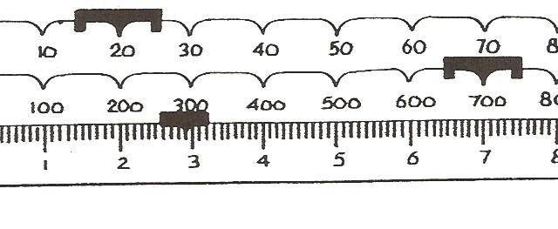
The final mass below is __________________

Slide 28
Scientific Method
The following notes include topics related to scientific method
Steps of the scientific method

Slide 29
Steps of the Scientific Method
To remember the order
Paul
Ran
Happily
Exiting
Rachel’s
Car
2.
3.
4.
5.
6.

Slide 30
Scientific Method
What is the scientific method?
Universal approach to scientific problems
Identify the PROBLEM
Always in the form of a question
Ex. Does ____________ more for a test increase the grade you will get on the test?
2. RESEARCH the problem
Gather ____________
Ex. Memory ____________ with practice, etc.

Slide 31
3. Form an HYPOTHESIS
Educated guess in form of IF…THEN…
Ex. If I studied _____________ for a test then my grade on the test will _______________.
4.Setting up a controlled EXPERIMENT
Only 1 variable is tested
a. Control group
Does not have a variable → treated with _____________
Ex. No _____________ before the test
b. Experimental group
Group that has the variable to be tested
Ex. _____________ before the test

Slide 32
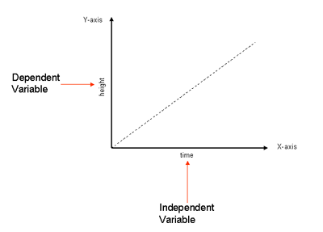
c. Independent variable (_____ Decide)
-Goes on the ______
Ex. __________ studying for test
d. Dependent variable (__________)
-goes on the ______
Ex. ________ on test

Slide 33
5. Recording and Analyzing ______________ Put data in graphs, tables, diagrams, and charts, and analyze the results. See if it supports your hypothesis
Dependent
Independent

Slide 34
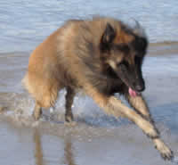
Data can be separated into two categories
_______________________ : is descriptive information (it describes something)
_______________________ : is numerical information (numbers).
Example: What do we know about Arrow the Dog?
Qualitative:
- He is brown and black
- He has long hair
- He has lots of energy
Quantitative:
He has 4 legs
He has 2 brothers
He weighs 25.5 kg
He is 565 mm tall

Slide 35
6. Drawing a CONCLUSION
Explanation supported by ________; answer to the problem
Ex. I earned 5 points ________ when I studied for my test than when I ______ _______ study.

