Slide 1
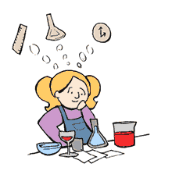
Unit 1: Measurement and The Scientific Method
Physical Science
Ms. Hanna

Slide 2
5 Senses

Slide 3
5 Senses
Sight

Slide 4
5 Senses
Sight
Hearing

Slide 5
5 Senses
Sight
Hearing
Taste

Slide 6
5 Senses
Sight
Hearing
Taste
Touch

Slide 7
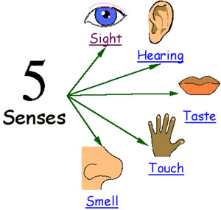
5 Senses
Sight
Hearing
Taste
Touch
Smell

Slide 8
Observation: To use your 5 senses to gather information
Inference: To give a possible explanation for an observation

Slide 9
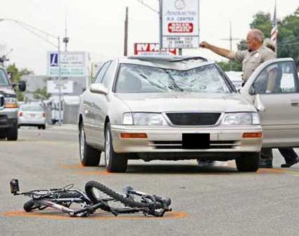
Observation:
Inference:

Slide 10
Observation/Inference Activity
Part 1 (15 seconds)
-3 observation, 3 inferences
Part 2 (15 seconds)
-3 observation, 3 inferences
Part 3-Final observations and inferences

Slide 11
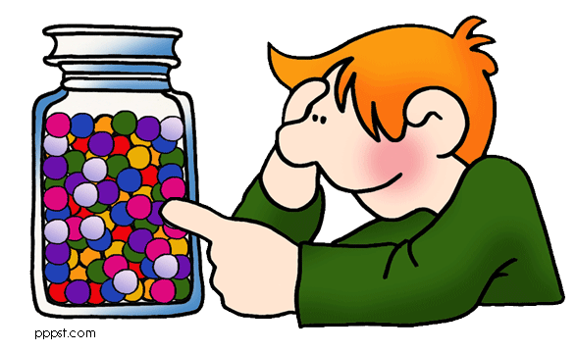
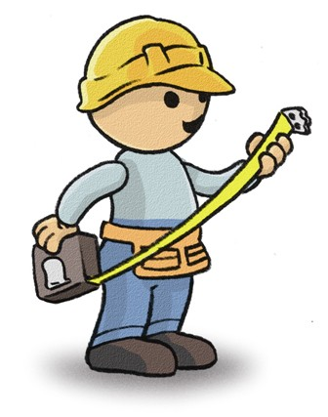
Estimate: to make a careful guess
Ex. How many pieces of candy
(M&Ms) are in the container?
________________
(put your name and guess on a sticky and pass it up!)
Measure: To find the exact amount of something
Ex. Measure the object on your desk in cm. Record your measurement for length and width below
length: ________________________
width : _________________________

Slide 12
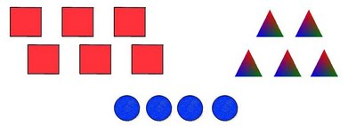
Predict: To guess about the future based on the past.
Ex. Predict what the weather will be like in two days
Temperature: _______________________
Climate (rain/cloudy/sunny):_________________
Classify: To group items based on how they are alike
Ex. Classify the group of animals in front of you in the bag. Write down below how or what characteristic you use to classify the animals.

Slide 13
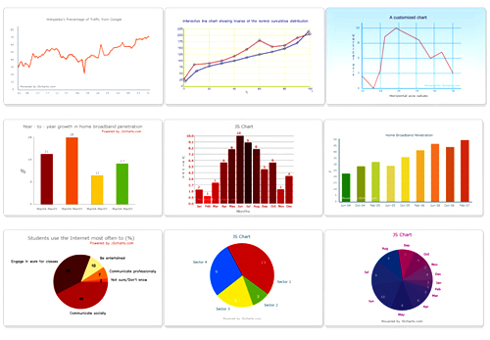
Hypothesize: To suggest an answer to a problem
Ex. What student do you think will have the middle most height in your class?
I believe that ___________________________ will have the middle most height
Was your hypothesis support or denied? ____________
Record and organize: To
take down observations
(data) and arrange them
into a graph or a chart

Slide 14
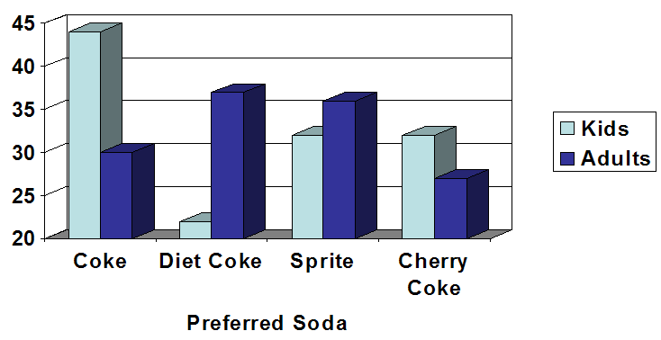
Conclusions: To give a logical result to a problem. Ex.
What is the preferred soda for kids?
Coke
What is the preferred soda for Adults?
Diet Coke
So if you were throwing a party for a bunch of families, what beverages would you buy and why?
73 people prefer Coke and 68 people preferred Sprite, so I would buy coke and sprite.

Slide 15
Measurement Skills
Converting through the metric system. Use the following chart to convert the measurements.
kids hide down under desks chewing mints
KILO → HECTO → DECA → (UNITS) → DECI → CENTI → MILLI
Km hm dam m dm cm mm
55 mm = __________________ cm
1.3 m = ___________________cm
15 m = ___________________ km
4.02 cm = ___________________mm
76.23 km = _________________________m
0.3 cm = ________________________m

Slide 16
Measurement Skills
Converting through the metric system. Use the following chart to convert the measurements.
kids hide down under desks chewing mints
KILO → HECTO → DECA → (UNITS) → DECI → CENTI → MILLI
Km hm dam m dm cm mm
55 mm = __5.5__ cm
1.3 m = ___________________cm
15 m = ___________________ km
4.02 cm = ___________________mm
76.23 km = _________________________m
0.3 cm = ________________________m

Slide 17
Measurement Skills
Converting through the metric system. Use the following chart to convert the measurements.
kids hide down under desks chewing mints
KILO → HECTO → DECA → (UNITS) → DECI → CENTI → MILLI
Km hm dam m dm cm mm
55 mm = __5.5__ cm
1.3 m = ___130__cm
15 m = ___________________ km
4.02 cm = ___________________mm
76.23 km = _________________________m
0.3 cm = ________________________m

Slide 18
Measurement Skills
Converting through the metric system. Use the following chart to convert the measurements.
kids hide down under desks chewing mints
KILO → HECTO → DECA → (UNITS) → DECI → CENTI → MILLI
Km hm dam m dm cm mm
55 mm = __5.5__ cm
1.3 m = ___130__cm
15 m = _0.015__ km
4.02 cm = ___________________mm
76.23 km = _________________________m
0.3 cm = ________________________m

Slide 19
Measurement Skills
Converting through the metric system. Use the following chart to convert the measurements.
kids hide down under desks chewing mints
KILO → HECTO → DECA → (UNITS) → DECI → CENTI → MILLI
Km hm dam m dm cm mm
55 mm = __5.5__ cm
1.3 m = ___130__cm
15 m = _0.015__ km
4.02 cm = _40.2__mm
76.23 km = _________________________m
0.3 cm = ________________________m

Slide 20
Measurement Skills
Converting through the metric system. Use the following chart to convert the measurements.
kids hide down under desks chewing mints
KILO → HECTO → DECA → (UNITS) → DECI → CENTI → MILLI
Km hm dam m dm cm mm
55 mm = __5.5__ cm
1.3 m = ___130__cm
15 m = _0.015__ km
4.02 cm = _40.2__mm
76.23 km = _76,230__m
0.3 cm = ________________________m

Slide 21
Measurement Skills
Converting through the metric system. Use the following chart to convert the measurements.
kids hide down under desks chewing mints
KILO → HECTO → DECA → (UNITS) → DECI → CENTI → MILLI
Km hm dam m dm cm mm
55 mm = __5.5__ cm
1.3 m = ___130__cm
15 m = _0.015_ km
4.02 cm = _40.2__mm
76.23 km = _76,230__m
0.3 cm = _0.003__m

Slide 22
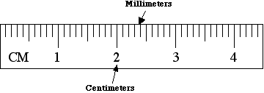
Measuring with a Metric Ruler
When measuring with a metric ruler all answers must be in decimal form and must include the centimeters followed by a decimal then the millimeters.

Slide 23
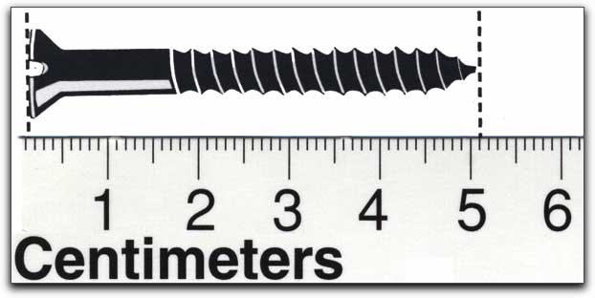
What is the measurement of the screw ?
In cm? ______________________
In mm? _____________________

Slide 24
What is the measurement of the screw ?
In cm? ____5.1 cm____
In mm? _____51 mm______

Slide 25
Measuring area using a ruler
Area = length X width
Units of area = cm² or mm² or m²
Find the area of the block below:
Show work below
F = L X W
S =
A =

Slide 26
Measuring area using a ruler
Area = length X width
Units of area = cm² or mm² or m²
Find the area of the block below:
Show work below
F = L X W
S = 7.2 cm x 2.0 cm
A =

Slide 27
Measuring area using a ruler
Area = length X width
Units of area = cm² or mm² or m²
Find the area of the block below:
Show work below
F = L X W
S =7.2 cm x 2.0 cm
A = 14.4 cm²

Slide 28
Measuring volume with a graduated cylinder
Graduated cylinders come in many different Sizes : including 10 ml, 25 ml, 50 ml, 100 ml, 500 ml, and 1000 ml.
Graduated cylinders are used to determine the volume of liquid solutions_.
An interesting characteristic of liquids in glass containers is that they curve at the edges due to cohesion forces (like a straw). This curvature is called the meniscus.
- With water in glass, the meniscus will curve up at the edges and down in the center, just like the smile on this smiley face.

Slide 29
When reading a graduated cylinder you want to:
- measure the lowest portion of the meniscus.
- be eye level with the top of the liquid
read the bottom of the meniscus
- Units for liquid volume = ml or L

Slide 30
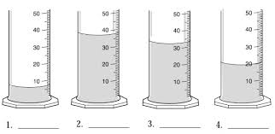
What are the volumes of these liquids?

Slide 31
What are the volumes of these liquids?
7 ml

Slide 32
What are the volumes of these liquids?
7 ml
38 ml

Slide 33
What are the volumes of these liquids?
7 ml
38 ml
34 ml

Slide 34
What are the volumes of these liquids?
7 ml
38 ml
34 ml
20 ml

Slide 35
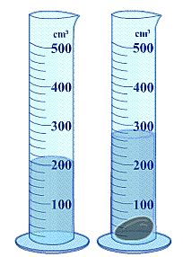
What is the volume of object?
Volume of the Liquid (A) = _________
Volume of the liquid and object (B) = ______
(B)-(A)= volume of object
Volume of object = ________

Slide 36
What is the volume of object?
Volume of the Liquid (A) = __200 ml_
Volume of the liquid and object (B) = ______
(B)-(A)= volume of object
Volume of object = ________

Slide 37
What is the volume of object?
Volume of the Liquid = __200 ml_
Volume of the liquid and object = __260 ml____
(B)-(A)= volume of object
Volume of object = ________

Slide 38
What is the volume of object?
Volume of the Liquid = __200 ml_
Volume of the liquid and object = __260 ml____
(B)-(A)= volume of object
Volume of object = _60 ml___

Slide 39
Measuring volume for solid objects using a ruler
Volume = Length X width X height
Units for volume = cm³ or mm³ or m³
Find the volume of the block below
Show work below:
F = l x w x h
S=
A=
4.2 cm
3.6 cm
9.4 cm

Slide 40
Measuring volume for solid objects using a ruler
Volume = Length X width X height
Units for volume = cm³ or mm³ or m³
Find the volume of the block below
Show work below:
F = l x w x h
S= 9.4 cm X 3.6 cm X 4.2 cm
A=
4.2 cm
3.6 cm
9.4 cm

Slide 41
Measuring volume for solid objects using a ruler
Volume = Length X width X height
Units for volume = cm³ or mm³ or m³
Find the volume of the block below
Show work below:
F = l x w x h
S= 9.4 cm X 3.6 cm X 4.2 cm
A= 142.1 cm³
4.2 cm
3.6 cm
9.4 cm

Slide 42
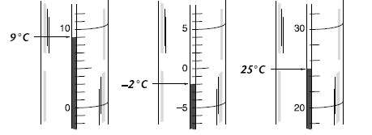
Measuring Temperature
Temperature is the measure of how hot or cold something is
The correct unit of temperature in the metric system is ° Celsius
Thermometers are read upward when temperatures are above zero
Thermometers are read downward when temperatures are below zero. They will also have a minus sign in front of the temperature.
Examples:

Slide 43
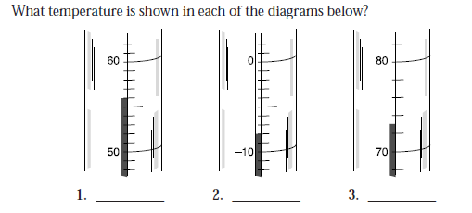
4. Suppose that at 9:00 A.M. the temperature of a room is 18°C, and at noon it is 24°C.What was the increase in temperature?

Slide 44
56 °C
4. Suppose that at 9:00 A.M. the temperature of a room is 18°C, and at noon it is 24°C.What was the increase in temperature?

Slide 45
56 °C
- 8 °C
4. Suppose that at 9:00 A.M. the temperature of a room is 18°C, and at noon it is 24°C.What was the increase in temperature?

Slide 46
56 °C
- 8 °C
73 °C
4. Suppose that at 9:00 A.M. the temperature of a room is 18°C, and at noon it is 24°C.What was the increase in temperature?
24 °C – 18 °C = 6 °C

Slide 47
Measuring Mass
A unit of mass in the metric system is the Grams(g)
Metric mass is measured in the science laboratory by the measuring device called a triple beam balance
The parts are all labeled in the picture to the below.

Slide 48
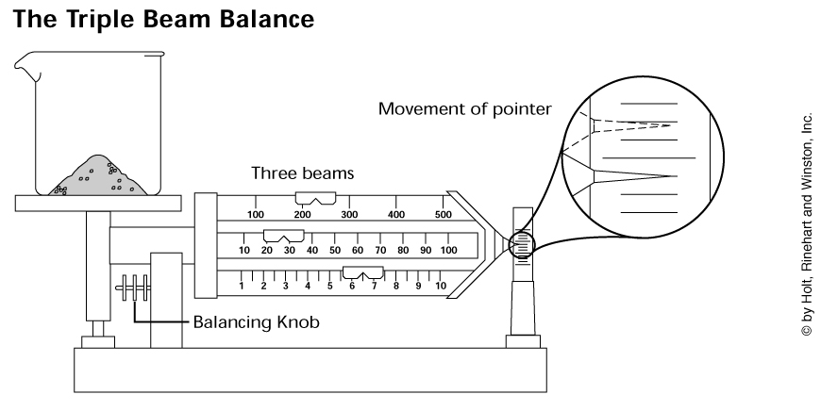
1) Check to see if the pointer is pointing to zero
- If the pointer is above the zero turn the knob towards (down) you
- If the pointer is below the zero turn the knob away (up) from you
2) Put the object on the measuring tray to find the mass.

Slide 49
STEPS TO USE TBB
1) Pointer is pointing to zero
Q: Pointer above the zero?
A: turn the knob towards you (down)
Q: Pointer below the zero
A: turn the knob away from you (up)
2) Put object on measuring tray

Slide 50
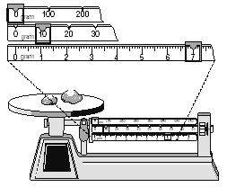
3) Move the riders
start with the 100s rider…stop at each 100. When the pointer drops, go back 1 space
then the 10s rider…stop at each 10. When the pointer drops, go back 1 space
lastly move the 1s rider until the pointer is on the line
4) Add all the riders together to get the final mass
EX: The final mass below is 17g

Slide 51
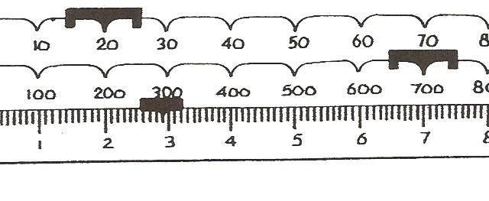
The final mass below is __________________

Slide 52
The final mass below is _722.9g_

Slide 53
Steps of the Scientific Method
PROBLEM
To remember the order
Paul
Ran
Happily
Exiting
Rachel’s
Car
2. RESEARCH
3. HYPOTHESIS
4. EXPERIMENT
5. RESULTS
6. CONCLUSION

Slide 54
Scientific Method
What is the scientific method?
Universal approach to scientific problems
Identify the PROBLEM
Always in the form of a question
Ex. Does studying more for a test increase the grade you will get on the test?
2. RESEARCH the problem
Gather information
Ex. Memory increases with practice, etc.

Slide 55
3. Form an HYPOTHESIS
Educated guess in form of IF…THEN…
Ex. If I studied more for a test then my grade on the test will increase.
4.Setting up a controlled EXPERIMENT
Only 1 variable is tested
a. Control group
Does not have a variable →treated with water
Ex. No studying before the test
b. Experimental group
Group that has the variable to be tested
Ex. Studying before the test

Slide 56
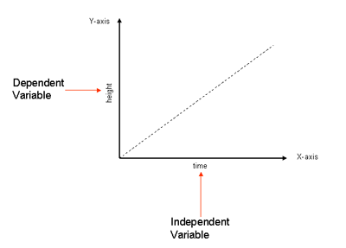
c. Independent variable (I Decide)
-Goes on the x axis
Ex. Time studying for test
d. Dependent variable (Data)
-goes on the y axis
Ex. Grade on test

Slide 57
5. Recording and Analyzing RESULTS Put data in graphs, tables, diagrams, and charts, and analyze the results. See if it supports your hypothesis
Dependent
Independent

Slide 58
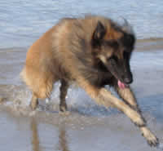
Data can be separated into two categories
Qualitative: is descriptive information (it describes something)
Quantitative: is numerical information (numbers).
Example: What do we know about Arrow the Dog?
Qualitative:
- He is brown and black
- He has long hair
- He has lots of energy
Quantitative:
He has 4 legs
He has 2 brothers
He weighs 25.5 kg
He is 565 mm tall

Slide 59
6. Drawing a CONCLUSION
Explanation supported by data; answer to the problem
Ex. I earned 5 points higher when I studied for my test than when I did not study.

